Slide 1

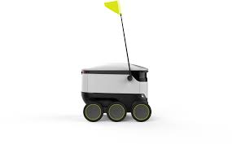
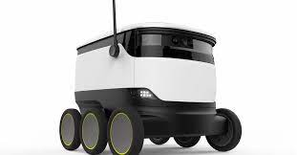
20CDT23 – Design Thinking
FOOD DELIVERY BY USING ROBOTS (TEAM 7)

Slide 2
TEAM 7
21CDR008 ---- CHAMMISH DHYANN KESHAV G
21CDR018 ---- KARTHIKA M
21CDR025 ---- MOHAMED AJMAL M
21CDR028 ---- NANDITA S
21CDR040 ---- SAM WILLSON S
21CDR053 ---- TAMIL ARASAN U

Slide 3
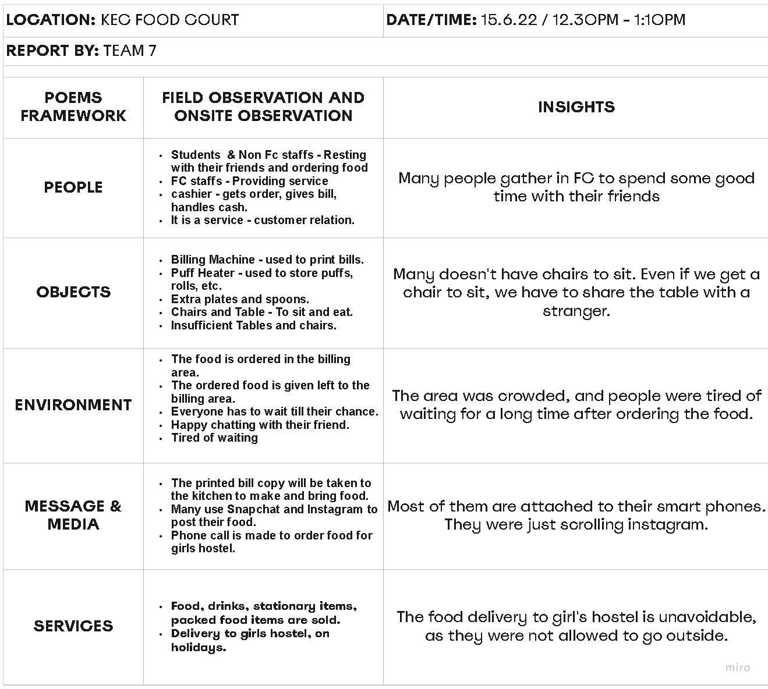
T16 : POEMS Framework

Slide 4
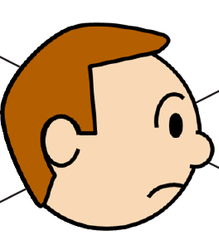



T17 :EMPATHY MAP – TO GENERATE INTERVIEW QUESTIONS
What are the features that is required to make our robot better?
What is your opinion about food delivery robot?
Would you feel any discomfortness with robots?
Which app would you use frequently to order food?
What type of food you prefer most?
What makes you angry while ordering food in online?
Which restaurant you would prefer most to order food?
What are the difficulties you are facing while ordering the food?
Is the ordered food delivered to you properly?
How much time it takes to deliver
the food?
What are the problems that you have been experienced in online order?
Which food is famous in your native place?
What are the problems that you are faced by the delivery person?
Would you be happy if robots deliver the food items?
PAIN?
GAIN?
Did you experience any difficulty in cancelling the order?
Would you interact with robot if it communicates with you?

Slide 5
TEMPLATE- 18
JOURNEY MAP
USER’S NAME: SANGAMESH SENGOTTIAN(RESTAURANT OWNER)

Slide 6
WHAT IS THE FIRST THING YOU DO WHEN YOU WAKE UP?
WHICH TIME DO YOU WAKE UP?
WHAT DO YOU EAT REGULARLY IN THE MORNING ?
AT WHAT TIME DO YOU COME TO THE OFFICE EVERYDAY?
WHAT IS THE FIRST THING YOU DO WHEN YOU GET INTO YOUR OFFICE?
WHEN DO YOU STARTED THIS HOTEL?
WHAT ARE THE PEAK HOURS IN YOUR HOTEL?
HOW MUCH YOU EARN FROM THIS HOTEL?
WHAT IS YOUR ANNUAL TURNOVER?
HAVE YOU EATEN IN THE OTHER HOTELS?
WHICH TYPE OF FOOD DO YOU LIKE?
WHAT IS YOU FAVOURITE FOOD?
WHAT DO YOU DO IN YOUR FREE HOURS?
HOW DO YOU SPEND YOUR TIME PRODUCTIVELY?
HOW DO YOU MANAGE TIME MANAGEMENT?
DO YOU ORDERED FOOD ONLINE?
DO YOU ORDER FOOD FREQUENTLY?
WHAT IS YOUR OPINION ABOUT FOOD DELIVERY ROBOTS?
WHICH APP DO YOU PREFER TO ORDER ONLINE?
DO SPEND TIME WITH YOUR FAMILY?
HOW MUCH TIME DO YOU SPEND WITH YOUR FAMILY?
DO YOU LIKE OUR PROJECT ?
DO YOU THINK FOOD DELIVERY ROBOTS ARE FUTURE?
DO YOU THINK FOOD DELIVERY ROBOTS IS POSSIBLE IN INDIA?
IS THERE ARE ANY OTHER THAT CAN WE ADD IN OUR BOT?

Slide 7
T19 - cOMBINED EMPATHY MAP AND JOURNEY MAP
DOING
SEEING
HEARING/SAYING
FEELING/
THINKING
NEEDS/
WANTS
FRUSTRATION
WHEN DELIVERED
FOOD IS CHANGED
SEARCHING
FOR EASIER
METHODS
VARIOUS
PAYMENT
METHODS
ORDERING
ONLINE
IS COSTLY?
TO GET
FOOD AT
RIGHT TIME
CAN GIVE ADD
COMPLIMENTRY
SEEING THE
RATING OF
THE FOOD &
THE APP
CAN GIVE
FREE DELIVERY
FOR ORDERING
MORE THAN
A CERTAIN PRICE
SOMETIMES
THE FOOD IS
PACKAGE IS
DAMAGED
DOES THE
FOOD GET
DELIVERED
CORRECTLY?
TO IMPROVE
THE USER
INTERFACE
OF APP
FIND WHICH
APP IS BEST
START TO
COMPARE
PRICES
THAT THE
PRICES OF
THE FOOD
IS LESS
DOES IT
HAS PAY
ON
DELIVERY?
DOES NOT
GIVING MORE
SIDE DISHES
IMPROVE
THE PACKAGE
QUALITY
WAITING FOR
LONG TIME

Slide 8
1
T20 : USER INTERVIEW NOTES
INTERVIEWER NAME
CHAMMISH , KARTHIKA
NOTE TAKER&OBSERVER
NANDITA ,AJMAL,SAMWILSON
INTERVIEWER NAME
SANTHOSH
INTERVIEWER CONTACT
DETAILS
9500442215
DATE/TIME OF
INTERVIEW
22nd JUNE/2.00PM
INTERVIEW LOCATION
IT PARK
INTERVIEW’S BACKGROUND INFORMATION
GENDER
MALE
AGE RANGE
38
PROFESSION
ASSISTANT PROFESSOR
EDUCATION
BACKGROUND
ME(completed)PhD
FAMILY
NUCLEAR FAMILY
HOBBIES
TRAVELLING
LIKES
NON VEG(MUTTON),TO LIVE A HAPPY LIFE
DISLIKES
FAST FOOD

Slide 9
INTERVIEW NOTES
(VERBATIM)
OBSERVATIONS/QUOTES
Family – 3members.
Education – UG in Nandha college,
PG in Anna university.
Cooking – don’t know.
Goes to restaurant (Punjabi/daba) monthly once.
Like to make friends.
Recently watched movie-vikaram.
Favourite hero – kamalahasan
Apps used for food ordering – swiggy&Zomato.
Mostly likes home food
Hate fast food.
Favourite food – non veg (mutton )
Mostly don’t like ordering food- because the quantity of food is not as expected.
Prefers Swiggy than Zomato because swiggy is more easy to use than Zomato.
Wish to change or modify – feedback system.
No problem with delivery persons.
Don’t like – tips giving system
In swiggy & Zomato.
Mostly orderd food – mutton
Disadvantages of robots-Feels that robots leads to unemployment of humans
To avoid that,it can be implemented in Colleges & Universities.
Advantages of robots-avoid human error,do the work properly.

Slide 10
2
INTERVIEWER NAME
AJMAL, KARTHIKA
NOTE TAKER&OBSERVER
NANDITA & CHAMMISH,SAMWILSON
INTERVIEWEE NAME
SANGAMESH SENGOTTIAN
INTERVIEWER CONTACT
DETAILS
9787699000
DATE/TIME OF
INTERVIEW
22nd JUNE/11.00AM
INTERVIEW LOCATION
PONNUSAMY RESTAURANT,PERUNDURAI
INTERVIEW’S BACKGROUND INFORMATION
GENDER
MALE
AGE RANGE
37
PROFESSION
BUSINESS
EDUCATION
BACKGROUND
MBA
FAMILY
JOINT FAMILY
HOBBIES
READING BOOKS,COOKING
LIKES
CHICKEN BIRIYANI
DISLIKES
GETTING ANNOYED WITH STARTUPS

Slide 11
INTERVIEW NOTES
(VERBATIM)
OBSERVATIONS/QUOTES
Family – 6 people
Hotel partners – family members.
Cooks chicken.
Education – MBA Australia
Favourite food – both veg & non-veg.
Reason for the hotel name – at first the hotel was run by another person,later he was bankrupted. So he take over and runs the hotel.
Another restaurant – erode spicy kitchen.
Special dish in hotel – nalllampatti (own recipe )
Most orders in hotel – biriyani
Opinion about robot delivery –check whether it works for the Indian attitude & Indian traffic
Dislikes –Hate people asking
Ratings for their work. And at usually startups ask orders, they promise lot of things beyond their limits,and later they don’t bother about it. And the expectations turn into irritation
According to him – delivery boys are worse nowdays. Food is not delivered properly .
for eg: they don’t use their bags properly.so the package is crumbled.
Disappointments – sometimes we experience fake feedbacks.
And people ask for refund without any issues.

Slide 12
3
INTERVIEWER NAME
CHAMMISH , KARTHIKA
NOTE TAKER&OBSERVER
NANDITA & AJMAL,SAMWILSON
INTERVIEWER NAME
NIRANCHAN D
INTERVIEWER CONTACT
DETAILS
9442646895/9629194754
DATE/TIME OF
INTERVIEW
22nd JUNE/2.00PM
INTERVIEW LOCATION
KONGU LIBRARY
INTERVIEW’S BACKGROUND INFORMATION
GENDER
MALE
AGE RANGE
19
PROFESSION
STUDENT
EDUCATION
BACKGROUND
1st YEAR CSD IN KEC
FAMILY
NUCLEAR FAMILY
HOBBIES
ARCHERY,READING BOOKS,
INTERNET SURFING
LIKES
EXPERIMENTING AND TESTING
NEW THINGS
DISLIKES
HOSTEL FOOD

Slide 13
INTERVIEW NOTES
(VERBATIM)
OBSERVATIONS/QUOTES
Area of interest – cyber security
Cooking - a little
Prefer online order.
Hobbies – reading books, utube and internet surfing.
Native – karaikkal
Dislikes – hostel food
And mostly prefer to be alone.
In his opinion – when elder people using apps to order online food,it is preferable to reduce adds. Because they don’t know what will do next.
Issues – recently he ordered food in online,but he didn’t receive that. He informed about the issues. And they refunded after 5 days.
Features recommened in robots- He wants to acces or open the robots even without having phone. So he need multiple options to open that like pin, etc.,

Slide 14
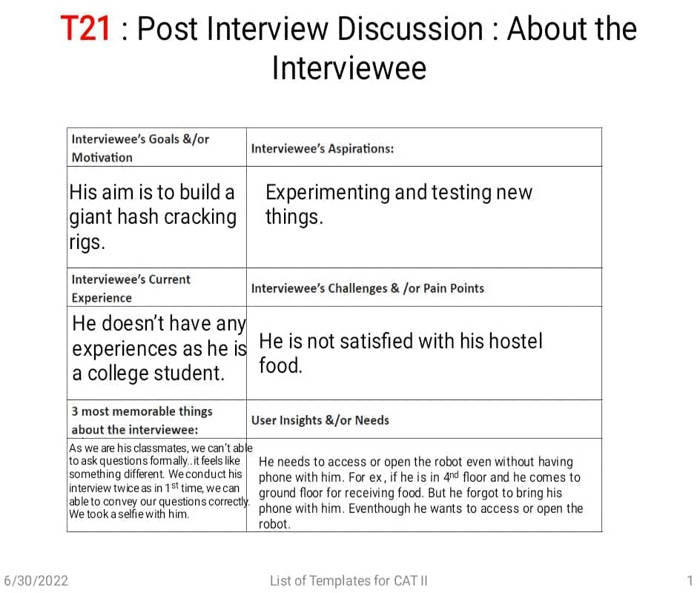

Slide 15
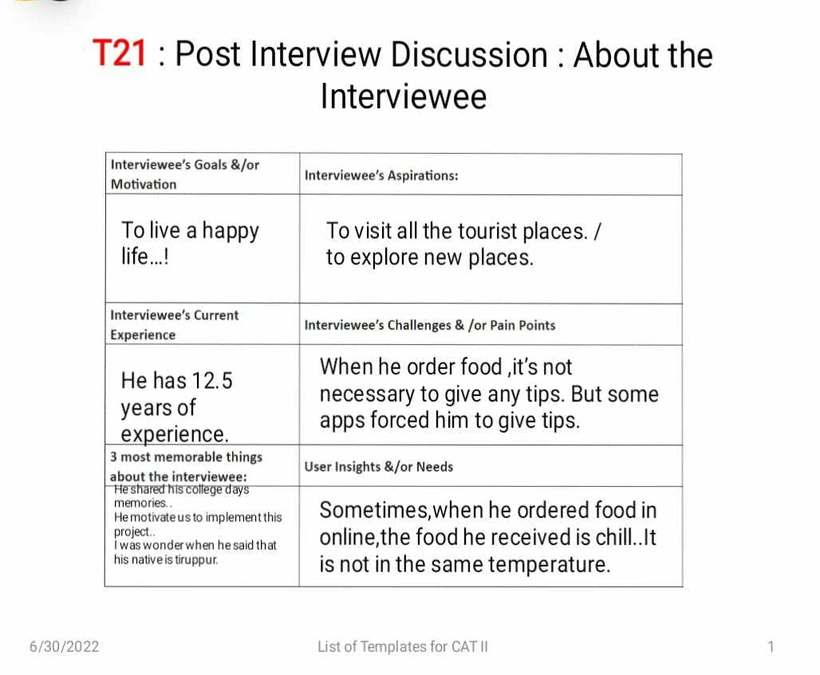

Slide 16
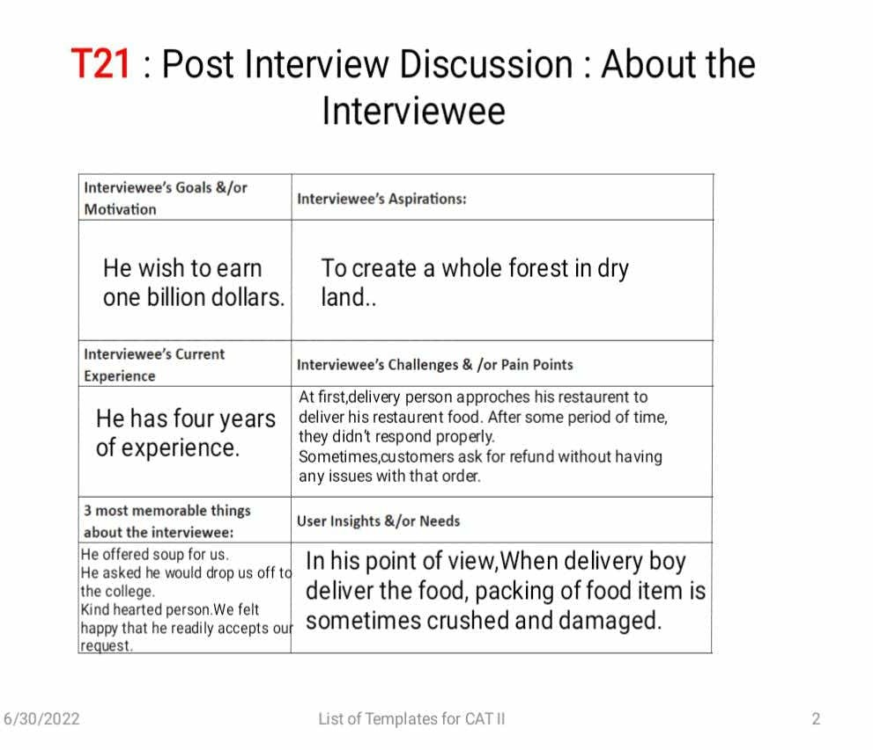

Slide 17
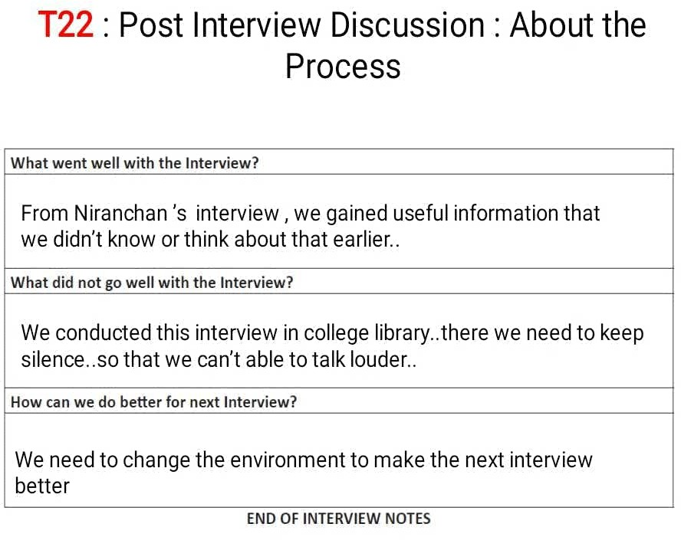

Slide 18
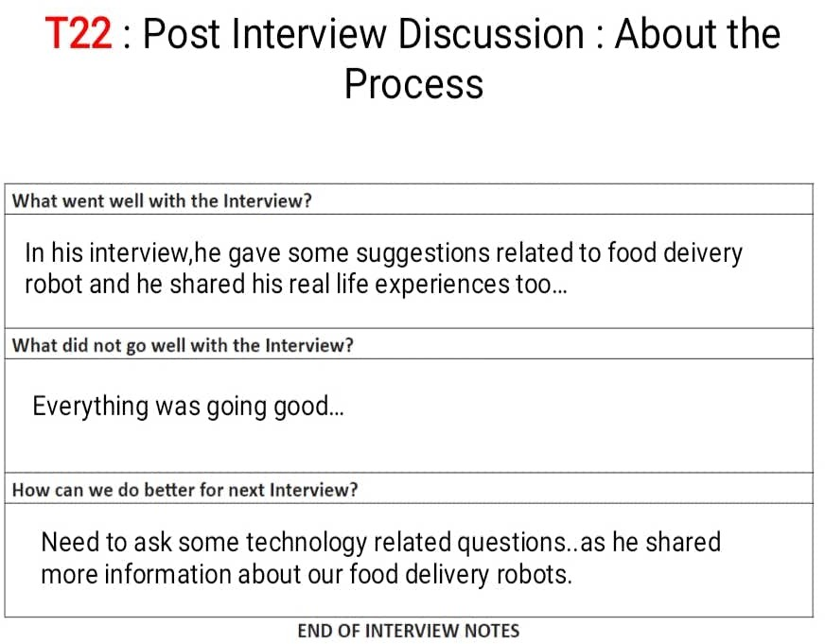

Slide 19
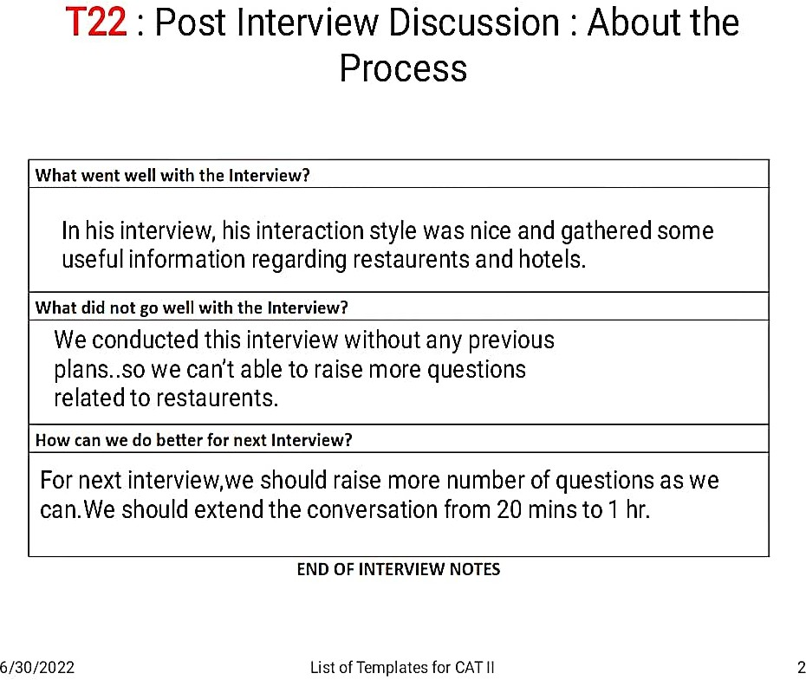

Slide 20
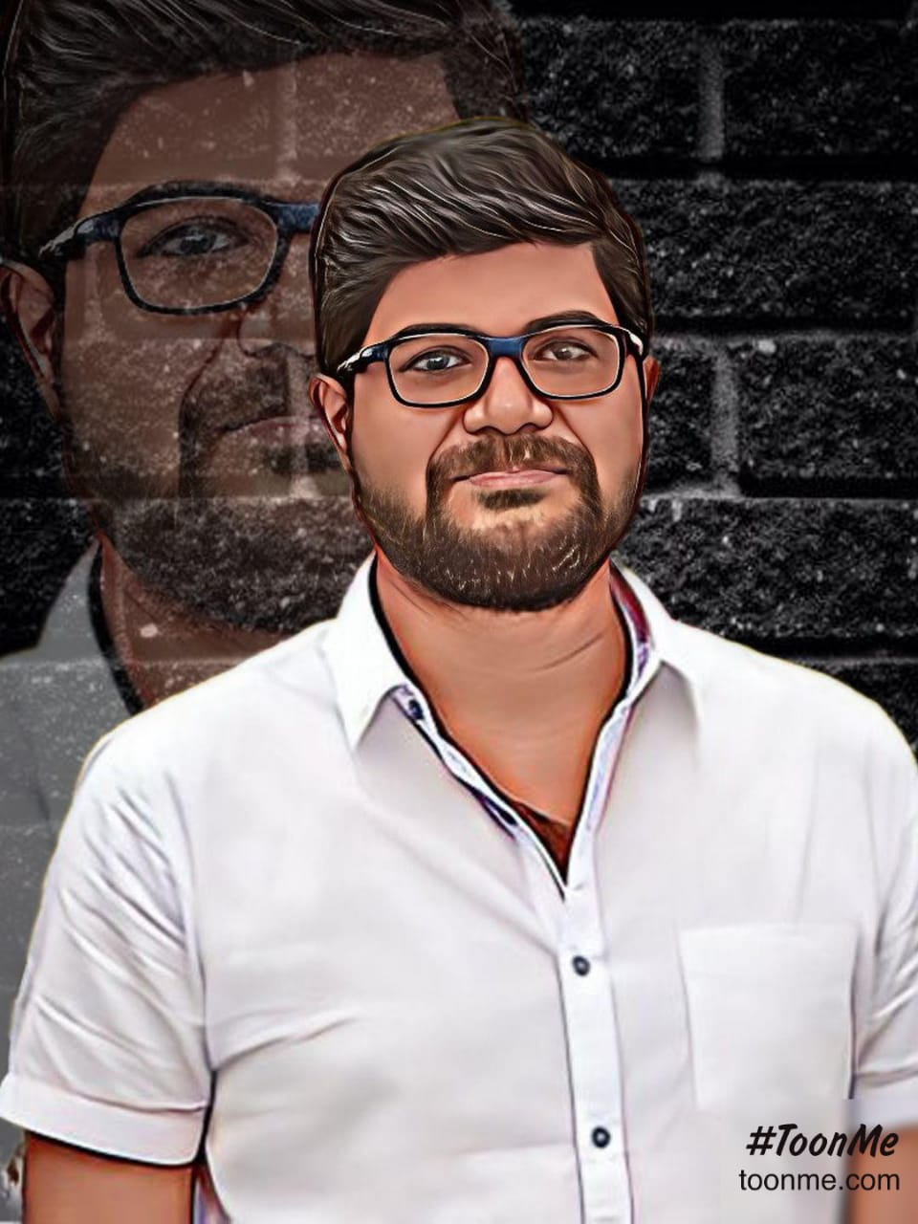
T23 : POST INTERVIEW DE-BRIEF PRESENTATION
Sangamesh sengotayan
GOALS/MOTIVATION :
He wish to earn one billion dollars.
ASPIRATION :
To create a whole forest in dry land.
CURRENT EXPERIENCE :
He has four years of experience.
CHALLENGES AND PAIN POINTS :
At first delivery person approaches his restaurant to
Deliver his restaurant food.after some period of time,
They didn’t respond properly.
3 MOST MEMORABLE THINGS ABOUT THE INTERVIEWEE :
He offered soup for us
He asked he would drop us off to the college
Kind hearted person.we felt happy that he readily
Accepts our request.
USER INSIGHT&DEEP NEEDS :
In his point of view , when delivery boy deliver the food ,
Packing of fod item is some times cryshed and damaged.

Slide 21
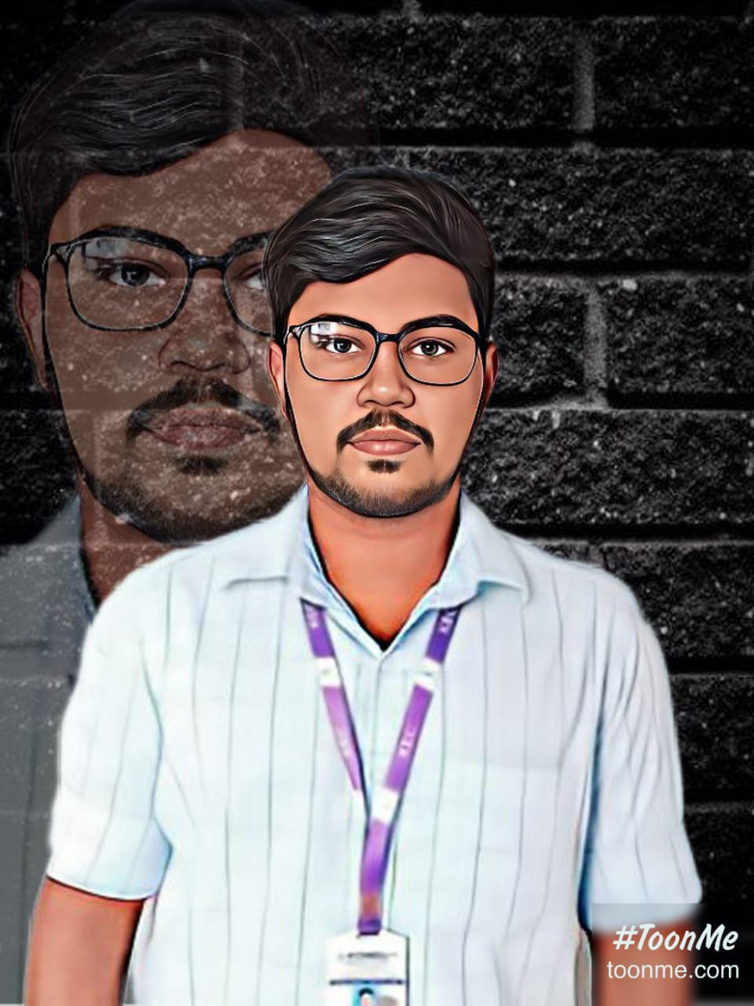
s
T23 : POST INTERVIEW DE-BRIEF PRESENTATION
NIRANCHAN
GOALS/MOTIVATION :
ASPIRATION :
His aim is to build a cracking rigs
Experimenting and testing new things.
CURRENT EXPERIENCE :
CHALLENGES AND PAIN POINTS :
He does not have any experiences as he is a college student.
He is not satisfied with his hostel food.
3 MOST MEMORABLE THINGS ABOUT THE INTERVIEWER :
USER INSIGHT & DEEP NEEDS :
As we are his classmates we cant able to ask question formally.It feels like something different . We conduct his interview twice as in 1 st time ,we can able to convey our questions correctly.We took a selfie with him.
He need to access or open the robot even without phone with him.If he is in 4 th floor and he comes to gground floor for receiving food But he forgot to bring phone with him. Eventhough he want to open the robot .

Slide 22
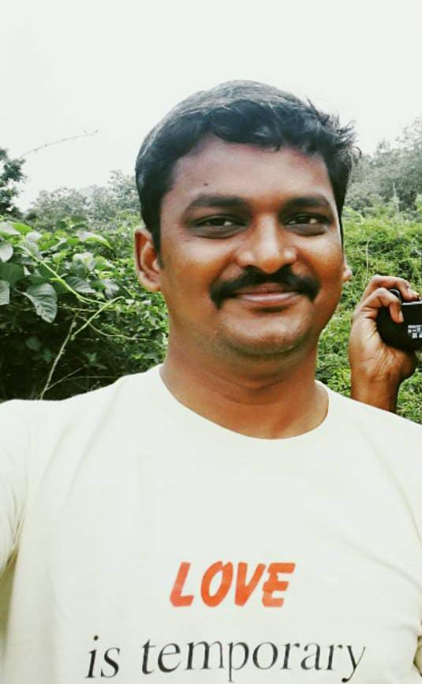
T23 : POST INTERVIEW DE-BRIEF PRESENTATION
Santhosh
GOALS/MOTIVATION :
ASPIRATION :
To live a happy life....!
To visit all the tourist places .
CURRENT EXPERIENCE :
CHALLENGES AND PAIN POINTS :
He has 12.5 years of experience.
When he order food , its not necessary to give any tips.BUt some apps forced him to give tips.
3 MOST MEMORABLE THINGS ABOUT THE INTERVIEWEE :
USER INSIGHT&DEEP NEEDS :
He shared his college day memories.
He motivate us to implement this project...
I was wonder when he said that his native is tiruppu.
Sometimes ,when he ordered food in online the food recived is chill...it is not in the same temperature.

Slide 23
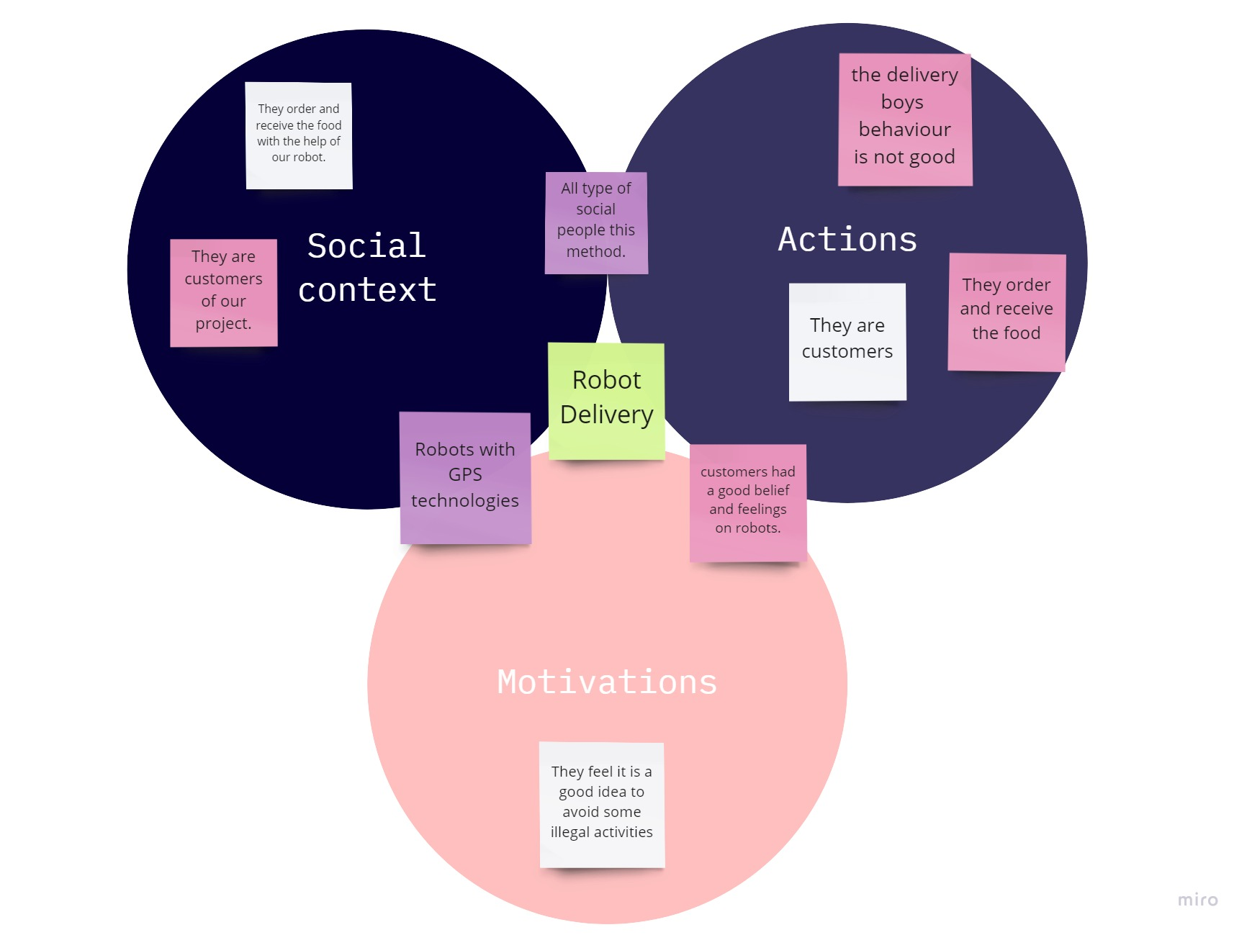
T24 : SAM Framework for Insight Mining / Need Finding

Slide 24
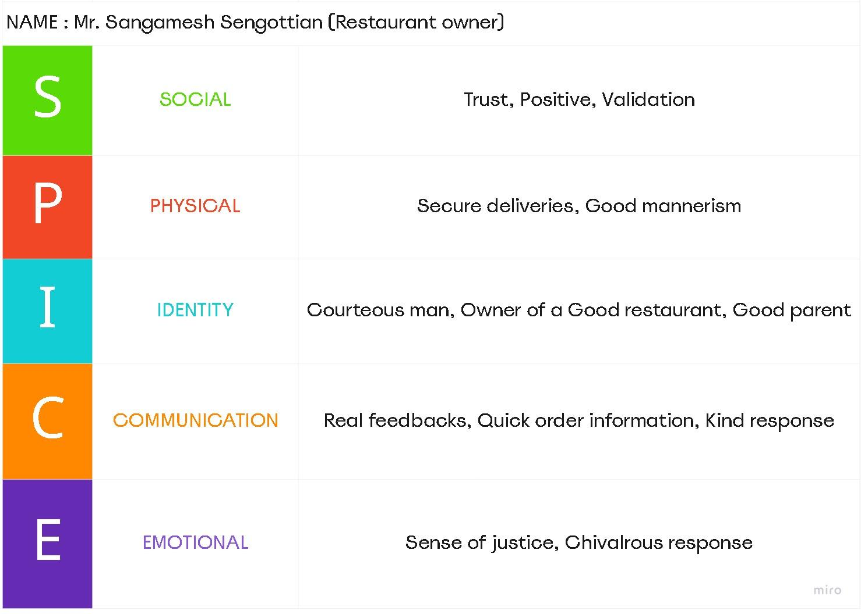
T25: SPICE Framework for Understanding & Uncovering Deep User Needs

Slide 25
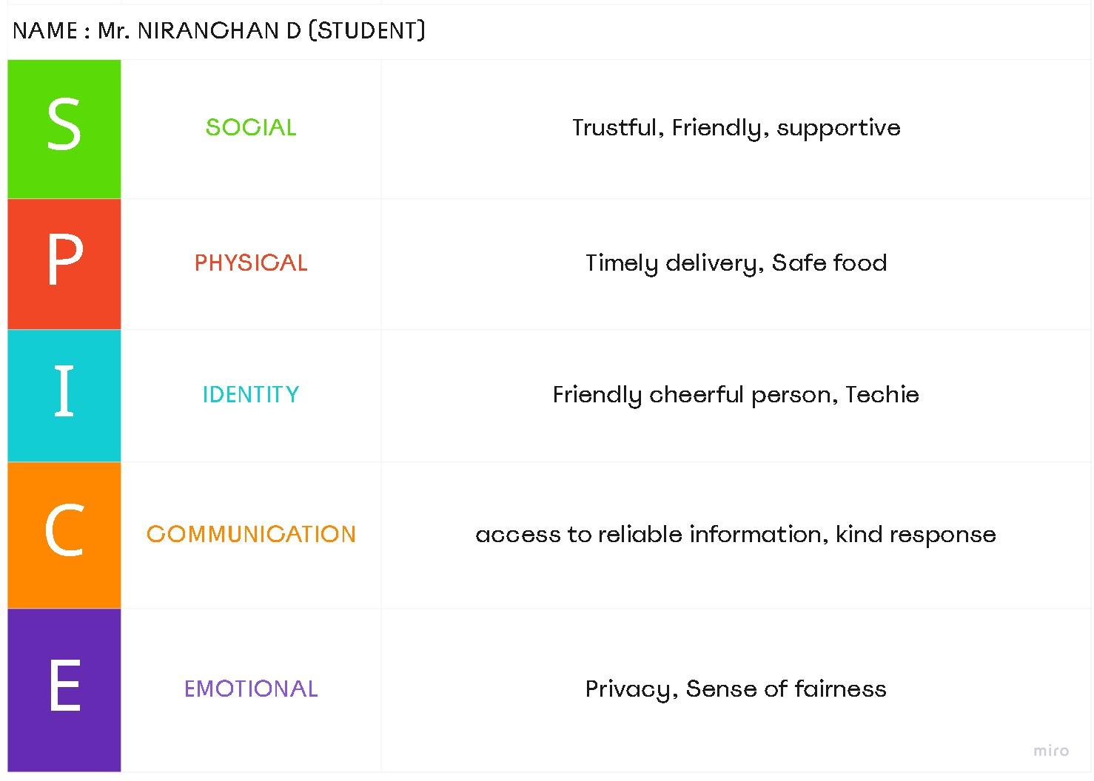
T25: SPICE Framework for Understanding & Uncovering Deep User Needs

Slide 26
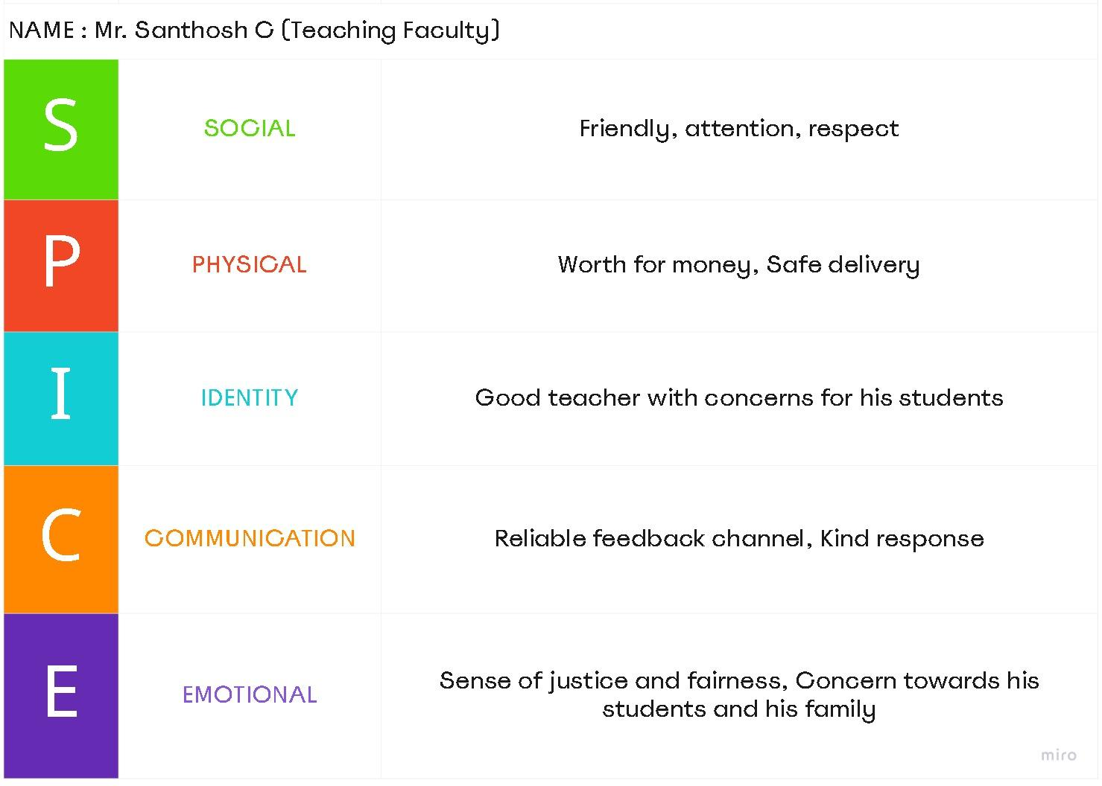
T25: SPICE Framework for Understanding & Uncovering Deep User Needs

Slide 27
T 26 -
NEED STATEMENTS
HARD WORK SHOULD BE REWARDED BY GOOD FOOD
WE CAN USE COMPETITIVE MARKETS TO ARRANGE FOR FOOD
DELIVERY OF OUR FOOD SUPPLY
MY THOUGHTS AND PRAYERS ARE WITH EVERY SINGLE FOOD
THAT GETS DELIVERED
IN THE RUSH YOU LIVE TO EARN TO SPEND TO EAT
TO DELIVER YOUR ORDER FILLS OUR HUNGARY WISHES

Slide 28
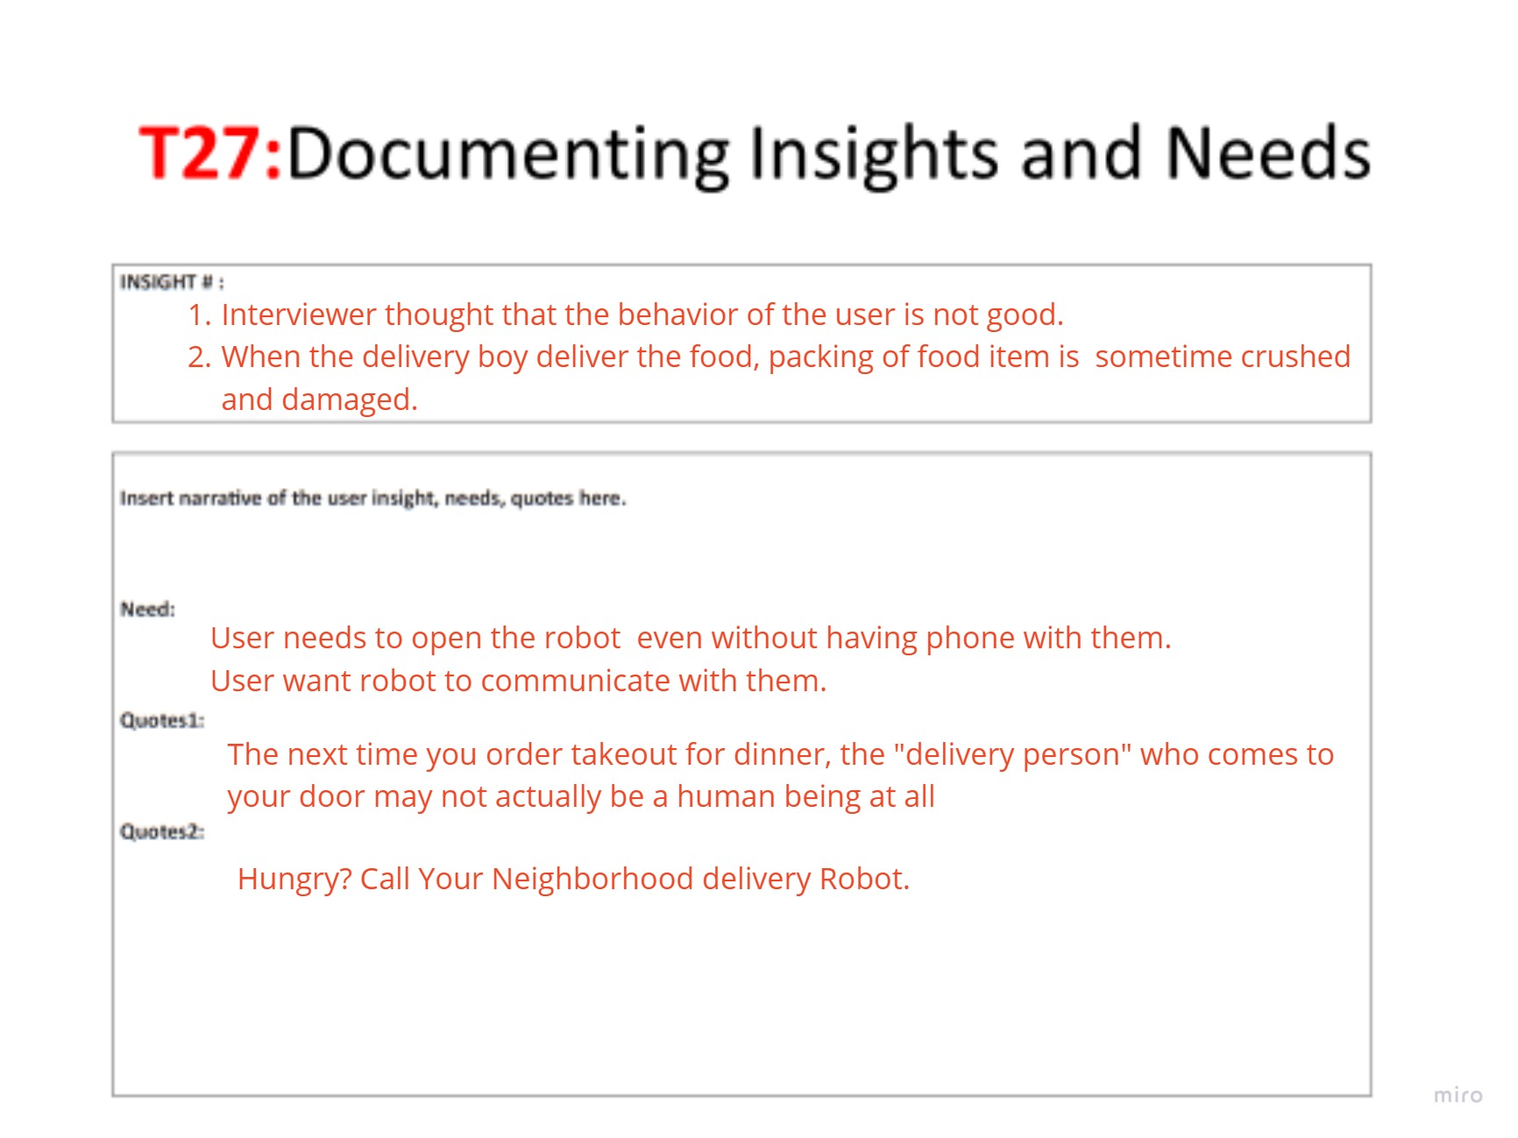

Slide 29
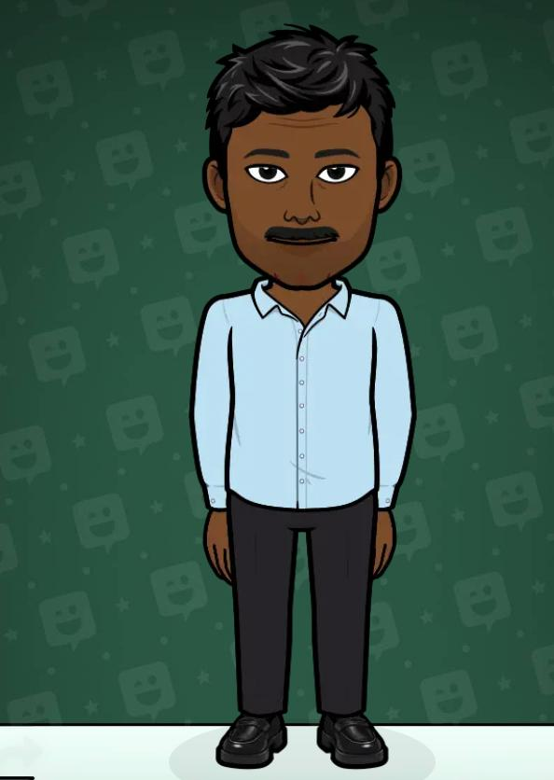
T28: Persona canvas
PERSONA CANVAS
PERSONA NAME: Santhosh
Goals:
To live a happy life…!
Deep Need Statements:
Demographic profile:
Age: 38
Gender: Male
Home: Tirupur
Family: Nuclear family
Education Background:
Comfortable food delivery.
Motivation/Aspiration:
To visit all the tourist places/to explore new places.
Diversity of Needs:
Hobbies/Likes/Dislikes:
Challenges/Pain Points:
When he order food ,it’s not necessary to give tips . But some app forced him to give tips.
Travelling
Likes:Non-Veg
Dislikes: Fast food
Social & Family Lifestyle:
Behaviour:
Middle class family.
Kind hearted persons

Slide 30
T28: Persona canvas
PERSONA CANVAS
PERSONA NAME: Niranchan
Goals:
His aim to build a giant hash cracking rigs
Deep Need Statements:
He is explain about the local apps.he also give tips to security of food.
Demographic profile:
Age: 18
Gender: male
Home: karikal
Family: Nuclear family
Education Background:B.E- CSD
Motivation/Aspiration:
Experimenting and testing new things.
Diversity of Needs:
Hobbies/Likes/Dislikes:
Archery ,reading books ,internet surfing.
Challenges/Pain Points:
He is not satisfied with the hostel food
Social & Family Lifestyle:
Upper middle class.
He is very silent boy.
Behaviour:
He is a kind hearted , person,he like to stay alone.

Slide 31
T28: Persona canvas
PERSONA CANVAS
PERSONA NAME: Sangamesh Sengottian
Goals:
He wish to earn one billion dollars
Deep Need Statements:
He interact very well with others.
Demographic profile:
Age: 37
Gender: Male
Home:Erode
Family:joint family
Education Background:MBA
Motivation/Aspiration:
To create a whole forest in a dry land.
Diversity of Needs:
Hobbies/Likes/Dislikes:
Cooking,like chicken briyani
Getting annoyed with startups.
Challenges/Pain Points:
When he order the food , it didn’t arrive correctly.
Social & Family Lifestyle:
Joint family,
Upper middle class.
Behaviour:
He is a kind hearted person
He interact well with others.

